Slide 1
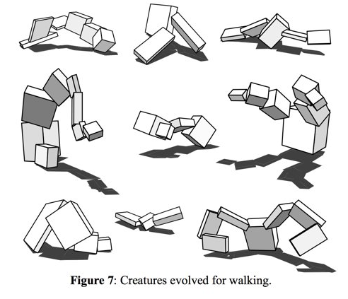
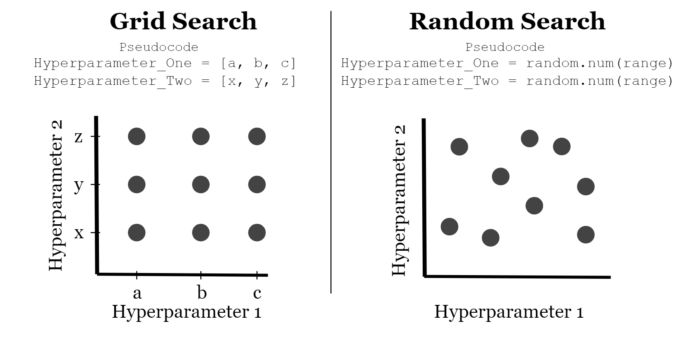
Name/Student Number: Ishmail Qasim/180021745 Email: 180021745@aston.ac.uk Supervisor: Peter Lewis
Evolving Virtual Creatures
An experimentation of Computational Intelligence in order to develop a self improving creature iteratively towards theoretical maximum efficiency.
Aims
Is the human body the most efficient implementation of a body than can carry out increasingly difficult tasks in the human world?
Is Bipedal the most efficient method of travel?
Are current autonomous production lines as efficient and low costs as they can be?
This project aims to create a space where these questions can be asked and answers can be given.
How?
Creating a graphical testing space for virtual creatures to carry out their respective tasks.
Creating a virtual creature to utilize this space in performing exercises such as travelling from point A to point B or carrying an object (including finding a way to pick up said object).
Producing an evolutionary algorithm to develop evolutionary behaviour based on random search principles.
Why?
Inspired by Karl Sims’ Evolution Simulation where the virtual space allowed virtual organisms to evolve, reproduce and improve much like in reality, however, slightly faster than a few billion years!
The issue with Sims’ implementation is that the creature selection was unspecific and just looked to observe the differences in evolutionary paths. This is where this project comes in.
Evolving Virtual Creatures aims to produce similar results with far more specific creature implementations and particular tasks for potential industry use.

